Slide 1

“Food Delivery Website and Application”
Task - 5

Slide 2
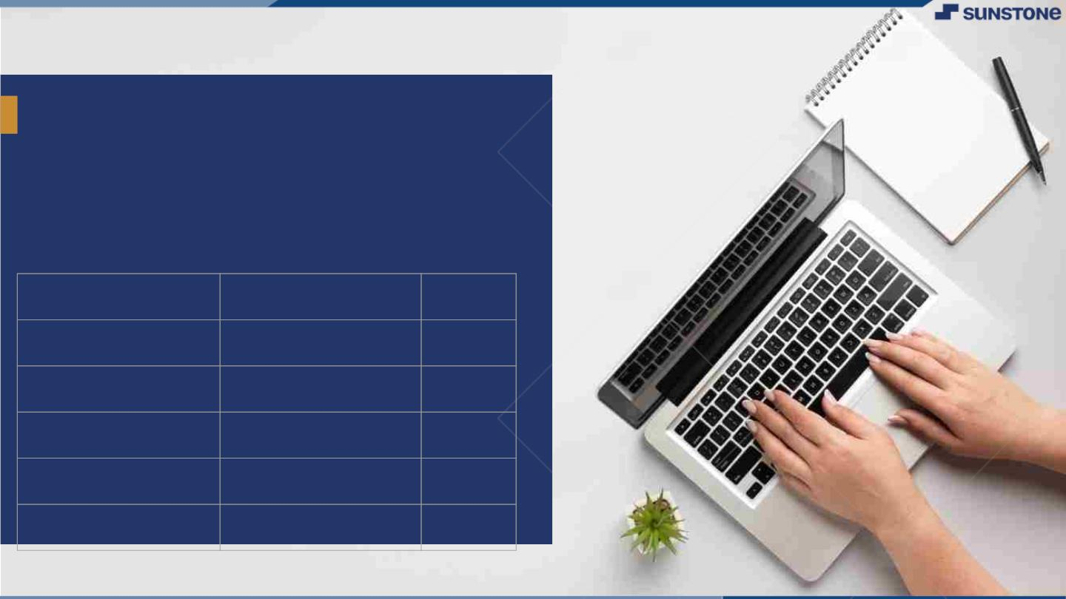
Food Delivery
Website and Application
▪
Food delivery apps are a type of restaurant delivery/ takeout software that connects consumers with local restaurants, grocery stores, convenience stores, etc., by providing a convenient way to order food that's delivered to their doorstep.
LMS Username
Name
Batch
au420420205013
Jayalakshmi
CA2
au4204202050017
Nandhini
CA2
au420420205006
Divyadharshini
CA2
au420420205020
priyadharshini
CA2

Slide 3
Task 5 :: Hosting (Module 5)
Hosting the website so that it can be accessed from anywhere
Host backend on aws with all environment setup
Make sure to whitelist api ports and host with the database
Migrate database to mongodb atlas
Build react app to be hosted on the server
Set hosted backed url to the frontend
Test entire frontend and backend
Evaluation Metric:
100% Completion of the above tasks
Learning outcome
Understand how to host a web api
How to deploy production ready react applications
Setting up environment for production

Slide 4

Step-Wise Description
Users start by creating an account on the website or app.
They can log in using email, social media accounts, or phone numbers.
Users explore a wide variety of restaurants and cuisines.
They can search for specific dishes, restaurants, or browse by categories.
Users select items from the menu of their chosen restaurant.
Detailed descriptions and images help them make informed choices.
Users choose from various payment methods (credit/debit cards, digital wallets).
The platform ensures a secure and smooth transaction process.
Users earn rewards or discounts through loyalty programs for repeat orders.
Users can manage their profiles, save favorite restaurants, and track order history.
Summary of your task
Discover the ultimate convenience with QuickBite, your go-to food delivery website and app. Dive into a world of culinary delights from local favorites to global cuisines, all delivered straight to your door. With an intuitive interface, real-time order tracking, and personalized recommendations, QuickBite ensures a seamless and delightful dining experience. Enjoy secure payments, exclusive discounts, and 24/7 customer support. Elevate your meals with QuickBite - where every bite is a celebration

Slide 5
Assessment Parameter
create AWS EC2 instance
build your react application for production
add all dependencies required for deployment
Check-List
forwared required ports on ec2 instance
Migrate entire database to mongodb atlas
set all environment varialble withs appropriate values
run node server on development using pm2 service manager
Host your react application on server

Slide 6
Submission Github
https://github.com/Priyadharshini1023/food-delivery-website.git

